Slide 1
Corporate Financial Dashboard

Slide 2
1.Market Capitalization Comparison by Company
Type: Bar Graph
Purpose: Show distribution of companies by market cap size
Why: Visualizing the market cap (Mar Cap - Crore) across companies helps identify the largest players and compare their relative sizes effectively, especially within the same cap category (e.g., Large Cap, Mid Cap).

Slide 3
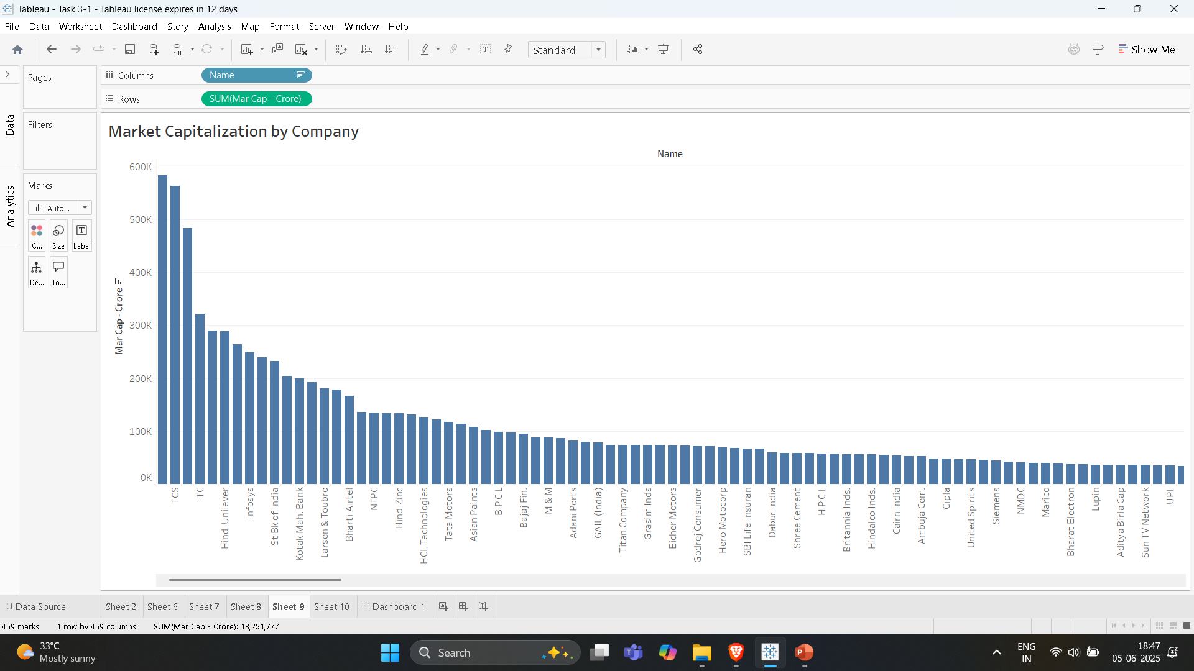

Slide 4
2. Top 10 Companies by Sales
Type: Bar Chart
Purpose: Rank companies based on quarterly sales
Why: Ranking companies by their quarterly sales gives immediate insights into which companies dominate in terms of revenue.

Slide 5
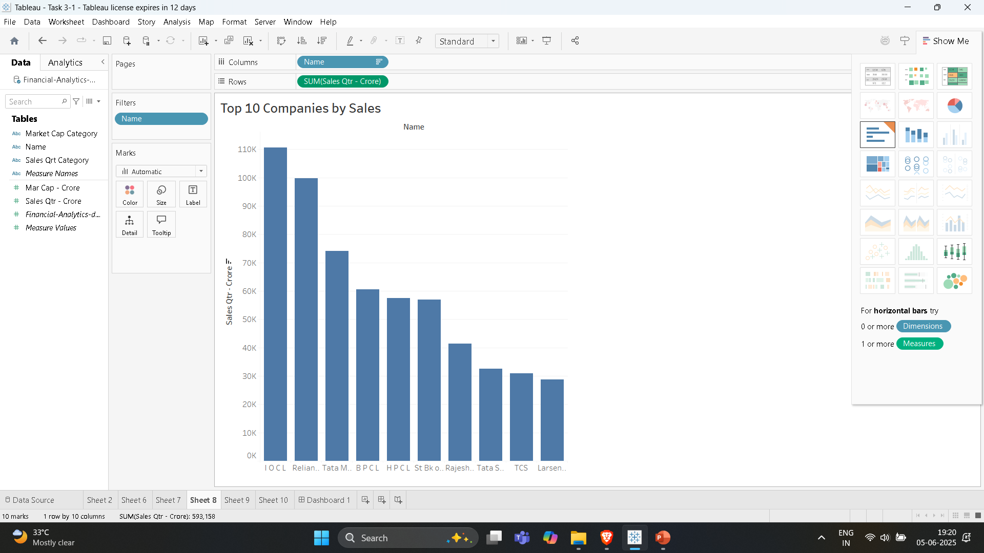

Slide 6
3. Sales Category Distribution
Type: Pie Chart
Purpose: Proportion of companies in High, Medium, Low sales
Why: Helps identify how many companies are High Sales, Medium Sales, or Low Sales, revealing sales concentration in the market.

Slide 7
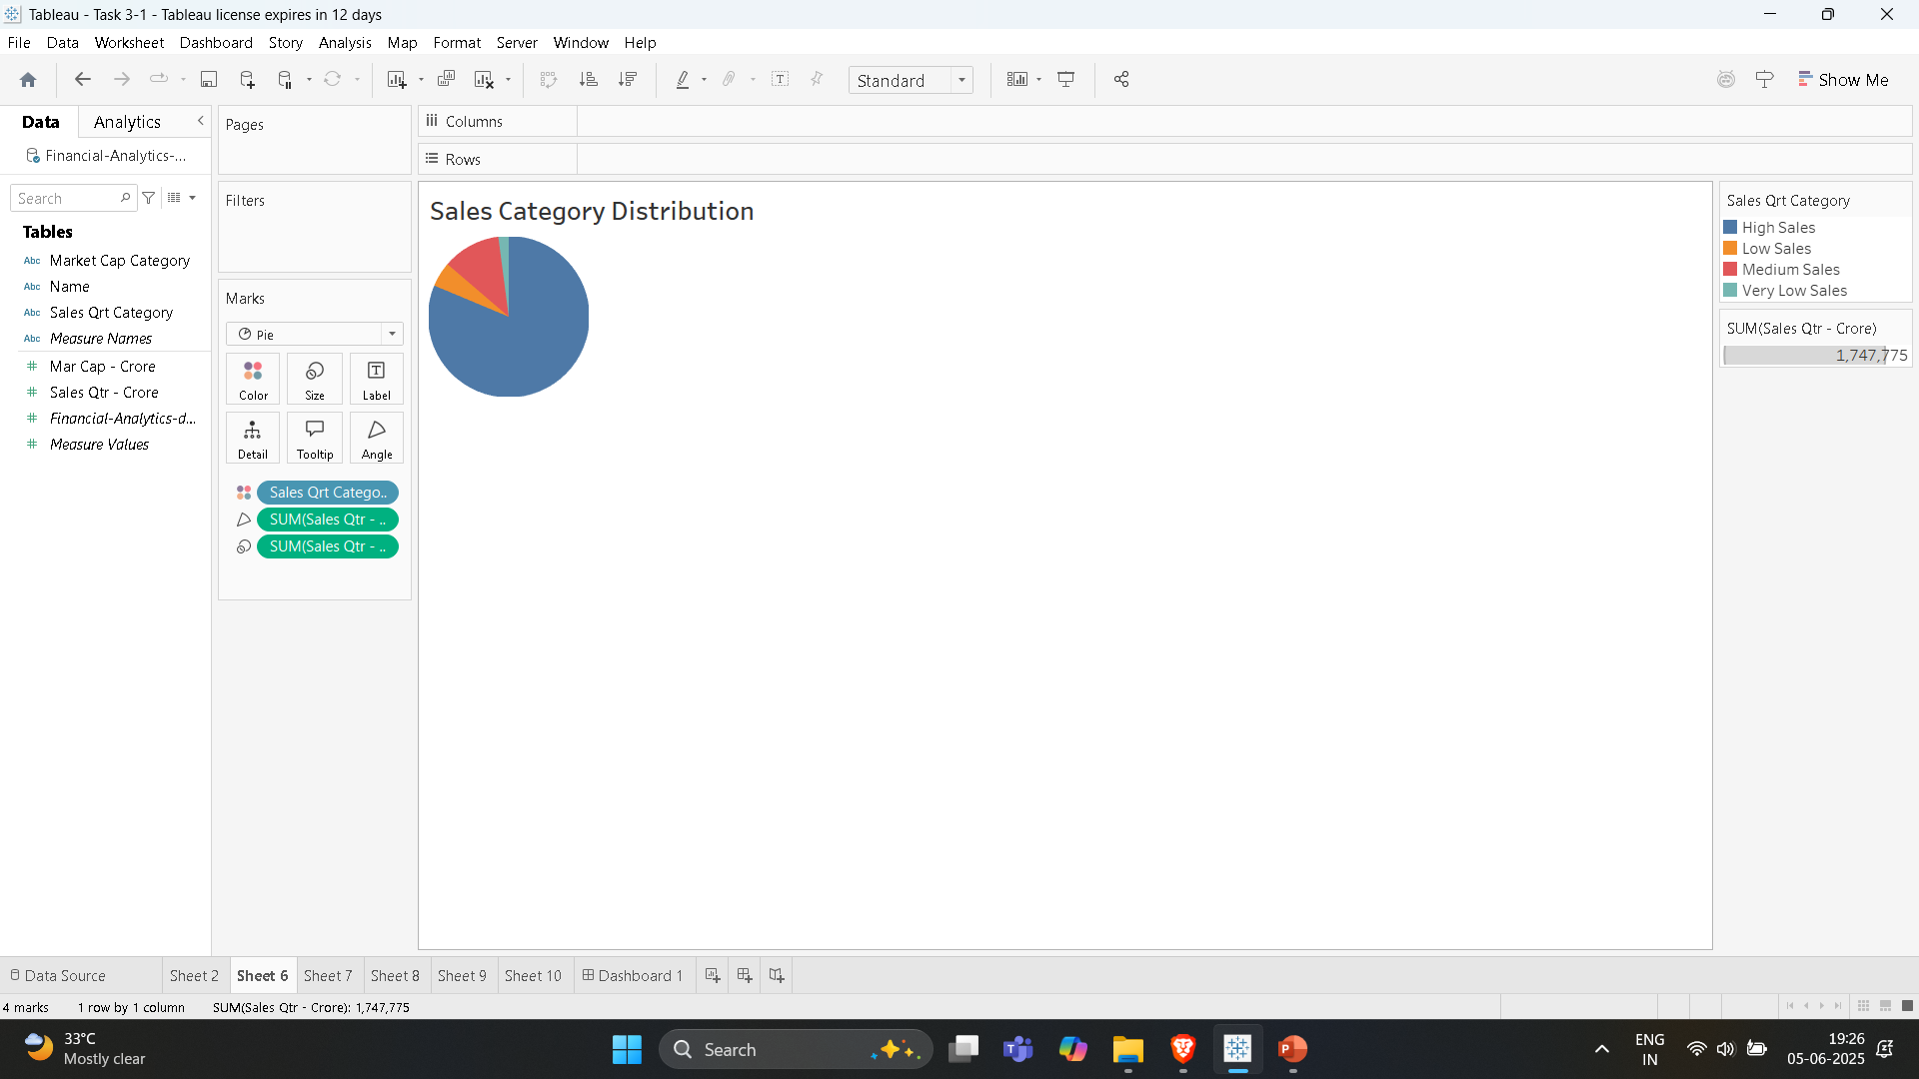

Slide 8
4. Quarterly Sales by Company
Type: Stacked Bar Chart
Purpose: Cross analysis between sales and company.
Why: Even though only one quarter is provided now (Sales Qtr - Crore), tracking this over time for multiple companies helps assess business performance, seasonality, or market demand.

Slide 9
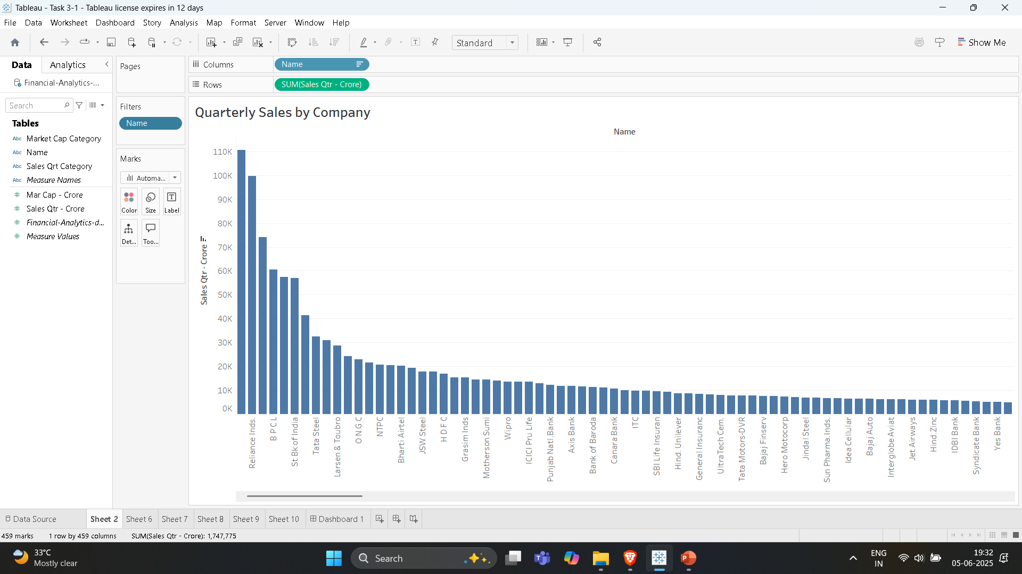

Slide 10
5. Market Cap Category vs Sales Category
Type: Stacked Bar Chart
Purpose: Cross analysis between market cap and sales tiers
Why: Helps identify whether companies with high market cap also generate high sales, revealing over- or under-valued firms relative to revenue.

Slide 11
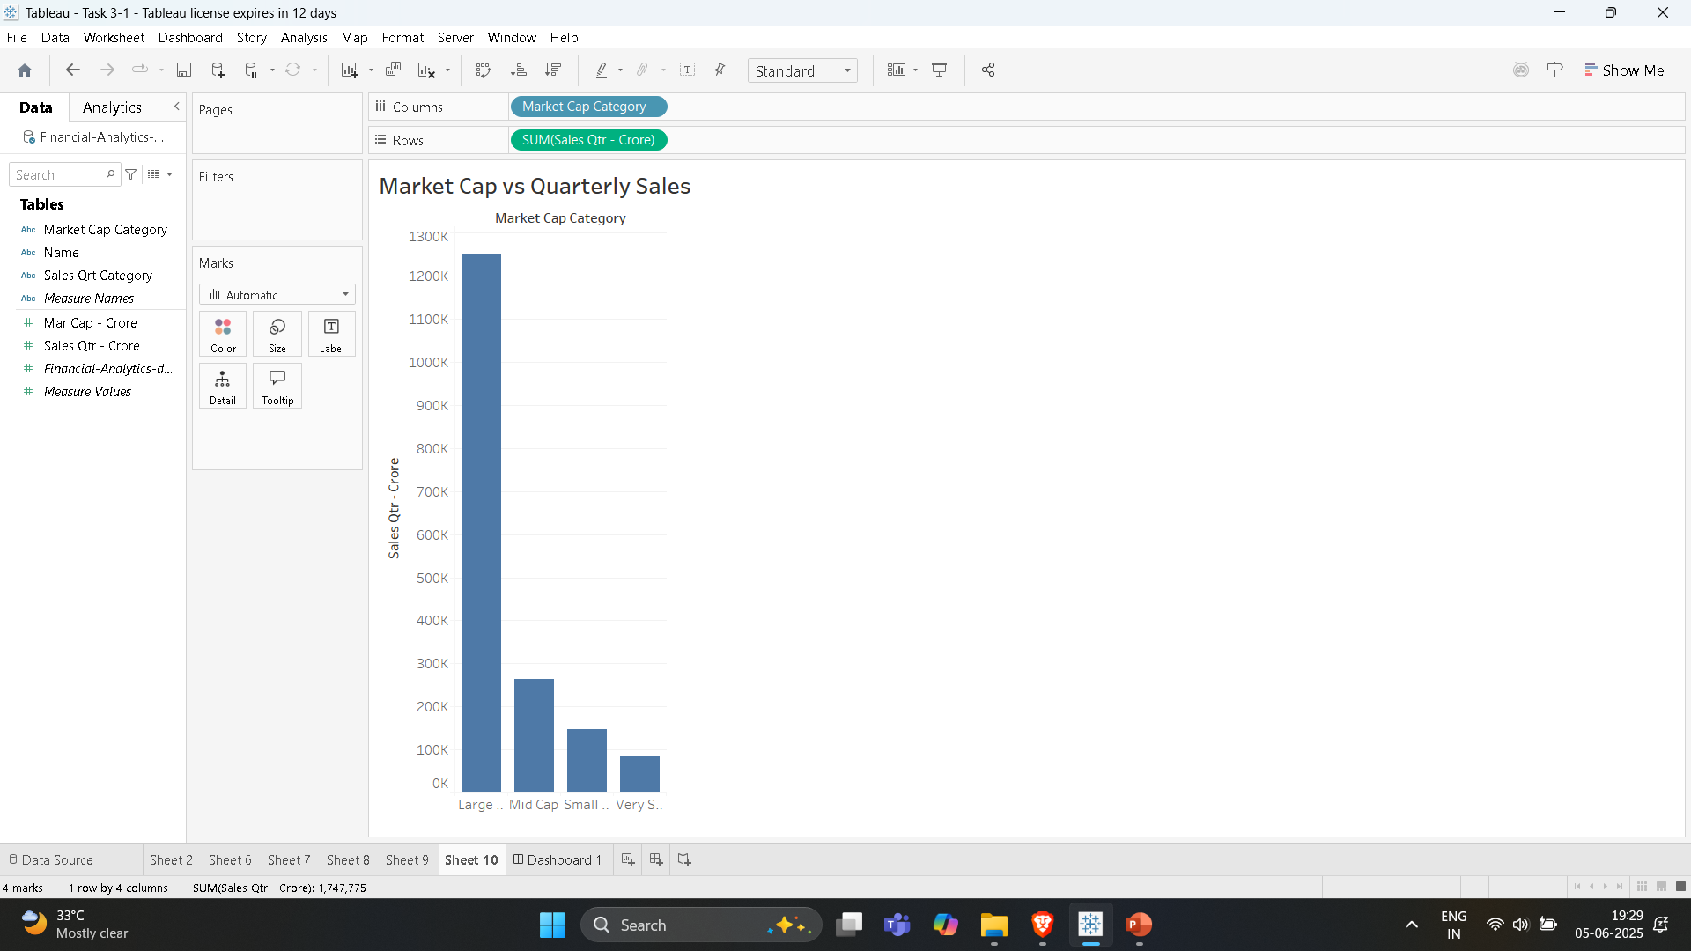

Slide 12
6. Market Cap Category Distribution
Type: Pie Chart
Purpose: Show distribution of companies by market cap size
Why: Shows the proportion of companies falling into Large Cap, Mid Cap, or Small Cap, useful for understanding the risk and size profile of the dataset.

Slide 13
